Slide 1


Presented By: Amit Sharma
[Bsc Data Science]
Presented To: Mr. Nitish Patil
[Assistant Professor], AAFT(SODS)
AAFT | SODS | 2024

Slide 2
TOPICS
1. Introduction to Database
2. Introduction to Functions & Grouping in SQL
3. Working with Tables
4. Data Analytics using SQL
5. MySQL connectivity with Python
6. Projects

Slide 3

Database
Database is collection of data in a format that can be easily accessed (Digital)
A software application used to manage our DB is called DBMS (Database Management System)

Slide 4


Types of Databases
Relational
Non-relational (NoSQL)
Data stored in tables
data not stored in tables
** We use SQL to work with relational DBMS

Slide 5
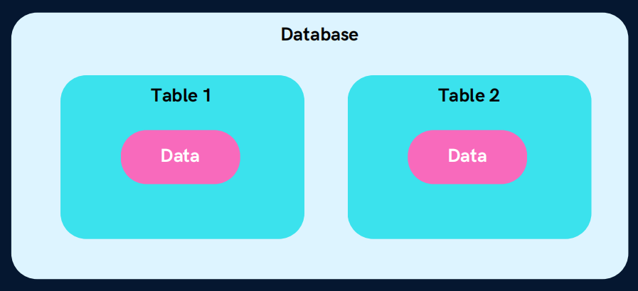
What is SQL?
Structured Query Language
SQL is a programming language used to interact with relational databases.
It is used to perform CRUD operations :
Create
Database Structure
Read
Delete
Update

Slide 6
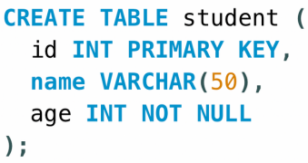
Creating our First Database
Our first SQL Query
CREATE DATABASE db_name;
DROP DATABASE db_name;
Creating our First Table
USE db_name;
CREATE TABLE table_name (
column_name1 datatype constraint,
column_name2 datatype constraint,
column_name2 datatype constraint
);

Slide 7
Types of SQL Commands
DDL (Data Definition Language) : create, alter, rename, truncate & drop
DQL (Data Query Language) : select
DML (Data Manipulation Language) : select, insert, update & delete
DCL (Data Control Language) : grant & revoke permission to users
TCL (Transaction Control Language) : start transaction, commit, rollback etc.

Slide 8
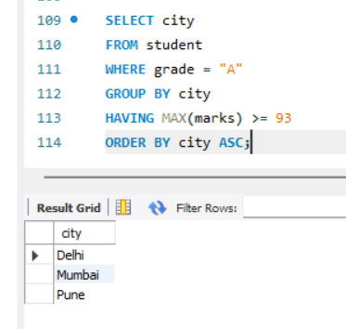
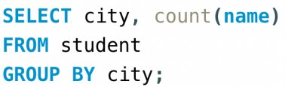
Group By Clause
Groups rows that have the same values into summary rows.
It collects data from multiple records and groups the result by one or more column.
*Generally we use group by with some aggregation function.
Count number of students in each city

Slide 9
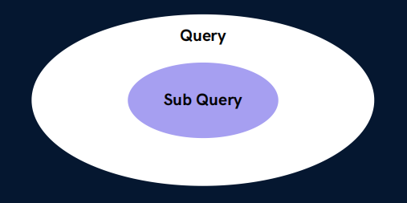
SQL Sub Queries
A Subquery or Inner query or a Nested query is a query within another SQL query.
It involves 2 select statements.
Syntax
SELECT column(s)
FROM table_name
WHERE col_name operator
( subquery );

Slide 10
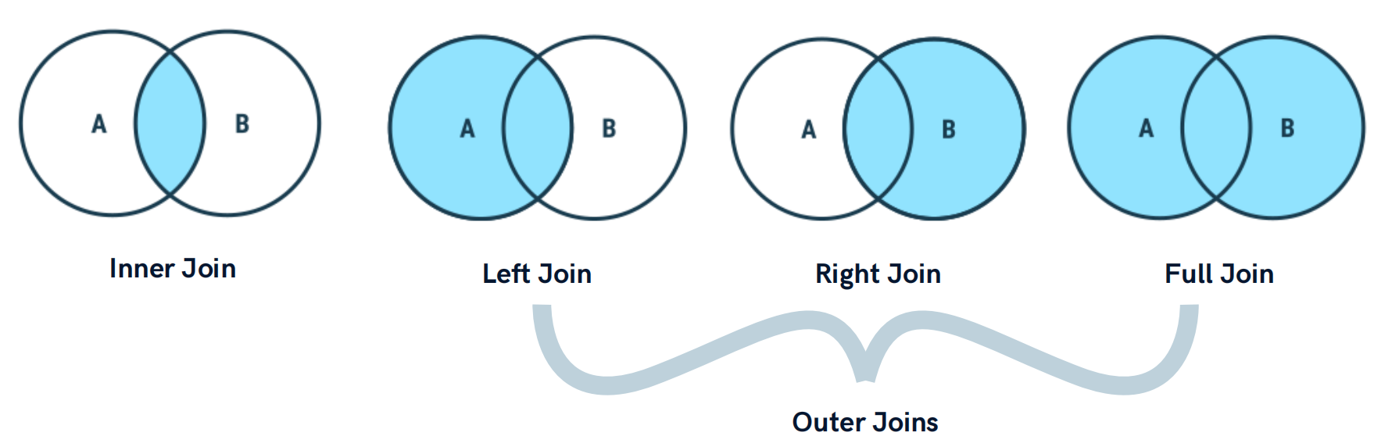
Types of Joins

Slide 11
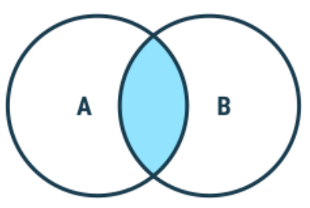
Inner Join
Returns records that have matching values in both tables
Syntax
SELECT column(s)
FROM tableA
INNER JOIN tableB
ON tableA.col_name = tableB.col_name;

Slide 12
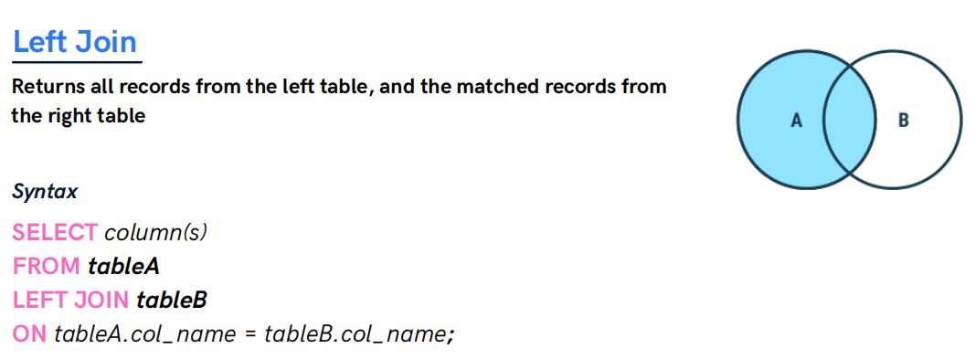
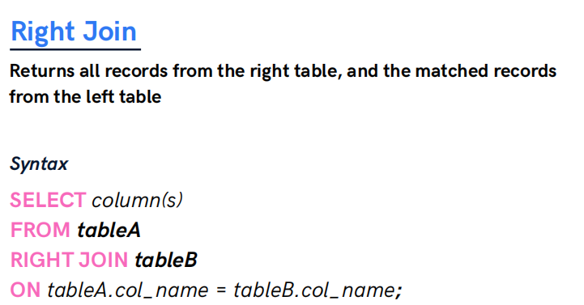
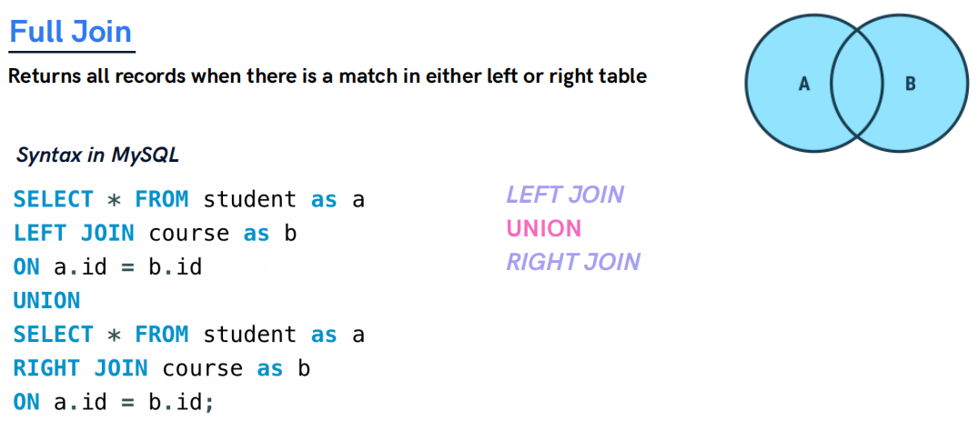

Slide 13
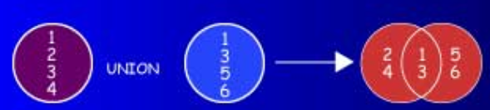
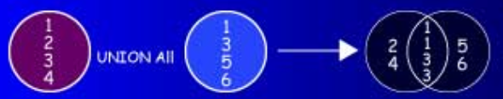
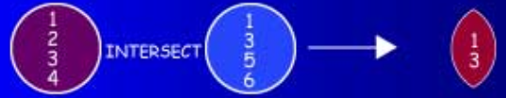
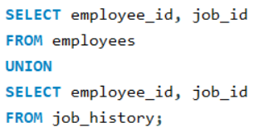
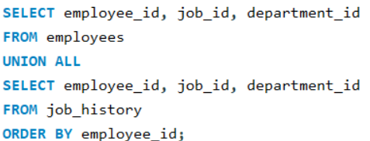
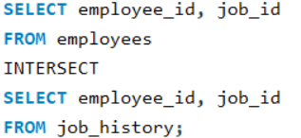
UNION
UNION ALL
INTERSECT
A U B
A UNION ALL B
A ∩ B
The UNION operator returns results from both queries
after eliminating duplications.
The UNION ALL operator returns results from both
queries, including all duplications.
Use the INTERSECT operator to return all rows common to multiple queries.

Slide 14
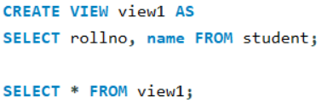
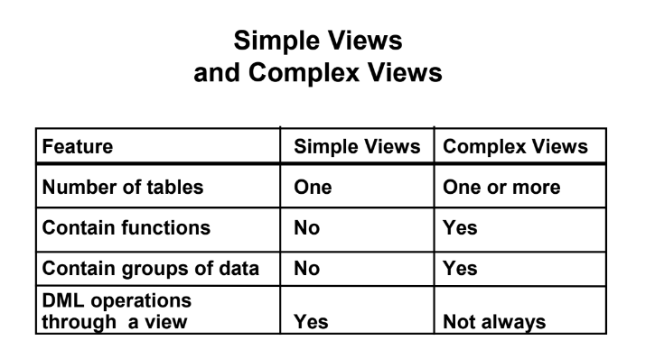
MySQL Views
A view is a virtual table based on the result-set of an SQL statement.
Types of Views
*A view always shows up-to-date data. The
database engine recreates the view, every time a
user queries it.

Slide 15
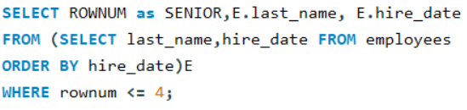
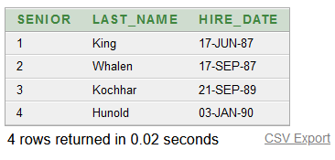
Top-N Analysis
• Top-N queries ask for the n largest or smallest
values of a column.
For example:
– What are the ten best selling products?
– What are the ten worst selling products?
• Both largest values and smallest values sets are
considered Top-N queries.

Slide 16
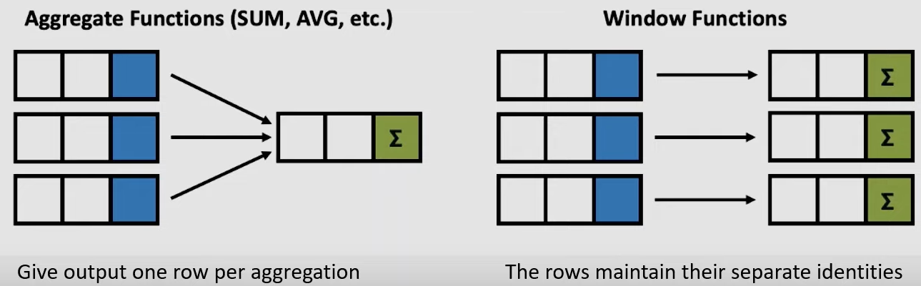
Window Function
Window functions applies aggregate, ranking and analytic functions over a particular window (set of rows).
And OVER clause is used with window functions to define that window.

Slide 17
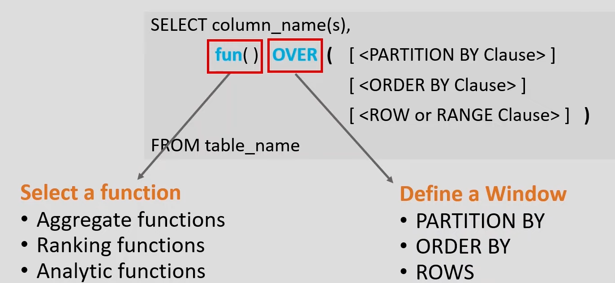
Window Function Syntax

Slide 18
Window Function Terms
Let’s look at some definations:
Window function applies aggregate, ranking and analytic functions over a particular window; for example, sum, avg, or row_number.
Expression is the name of the column that we want the window function operated on. This may not be necessary depending on what window function is used.
OVER is just to signify that this is a window function.
PARTITION BY divides the rows into partitions so we can specify which rows to use to compute the window function.
ORDER BY is used so that we can order the rows within each partition.
This is optional and does not have to be specified.
ROWS can be used if we want to further limit the rows within our partition. This is optional and usually not used.

Slide 19
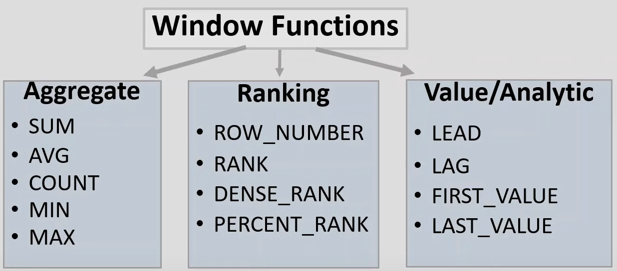
Window Function Types
There is no official division of the SQL window functions into categories but high level
we can divide into three types:

Slide 20
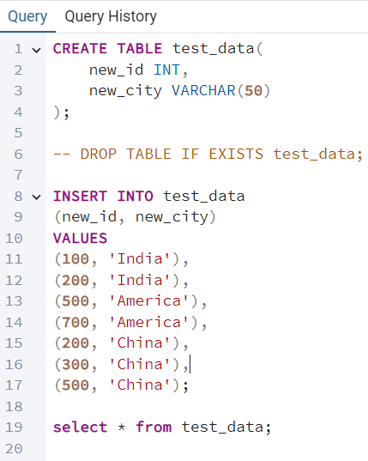
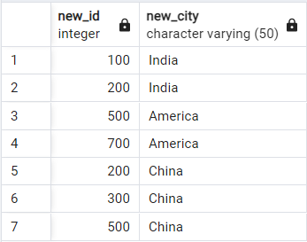

Slide 21
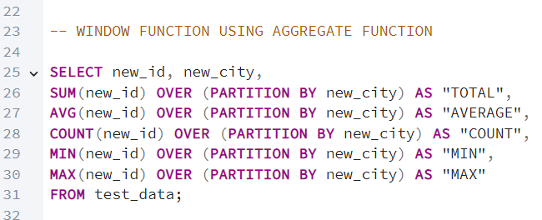
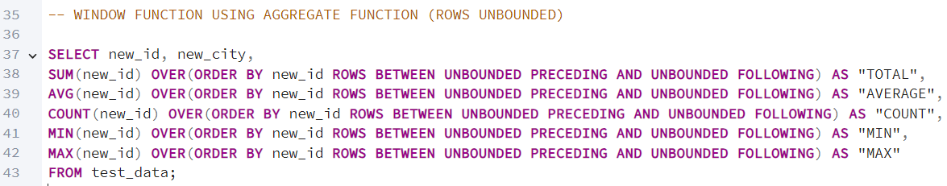
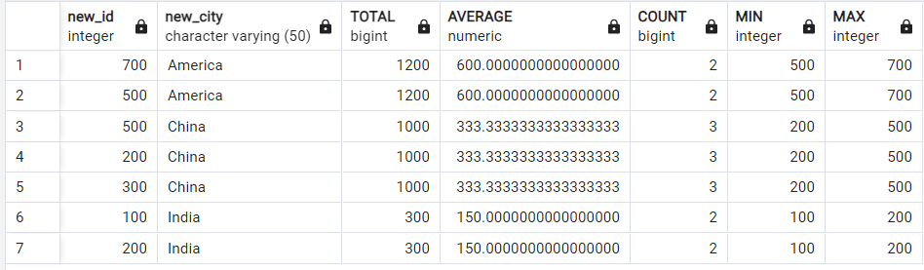
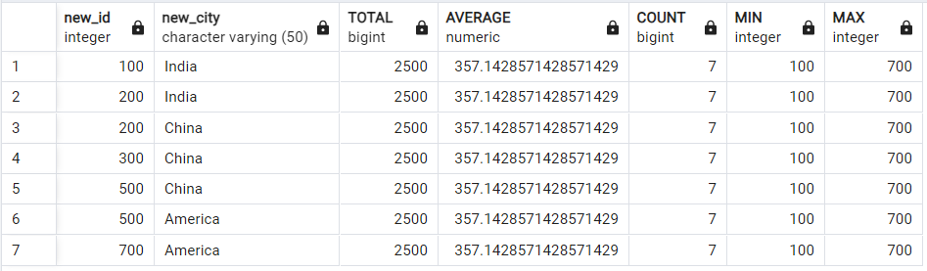
Window Function Codes

Slide 22
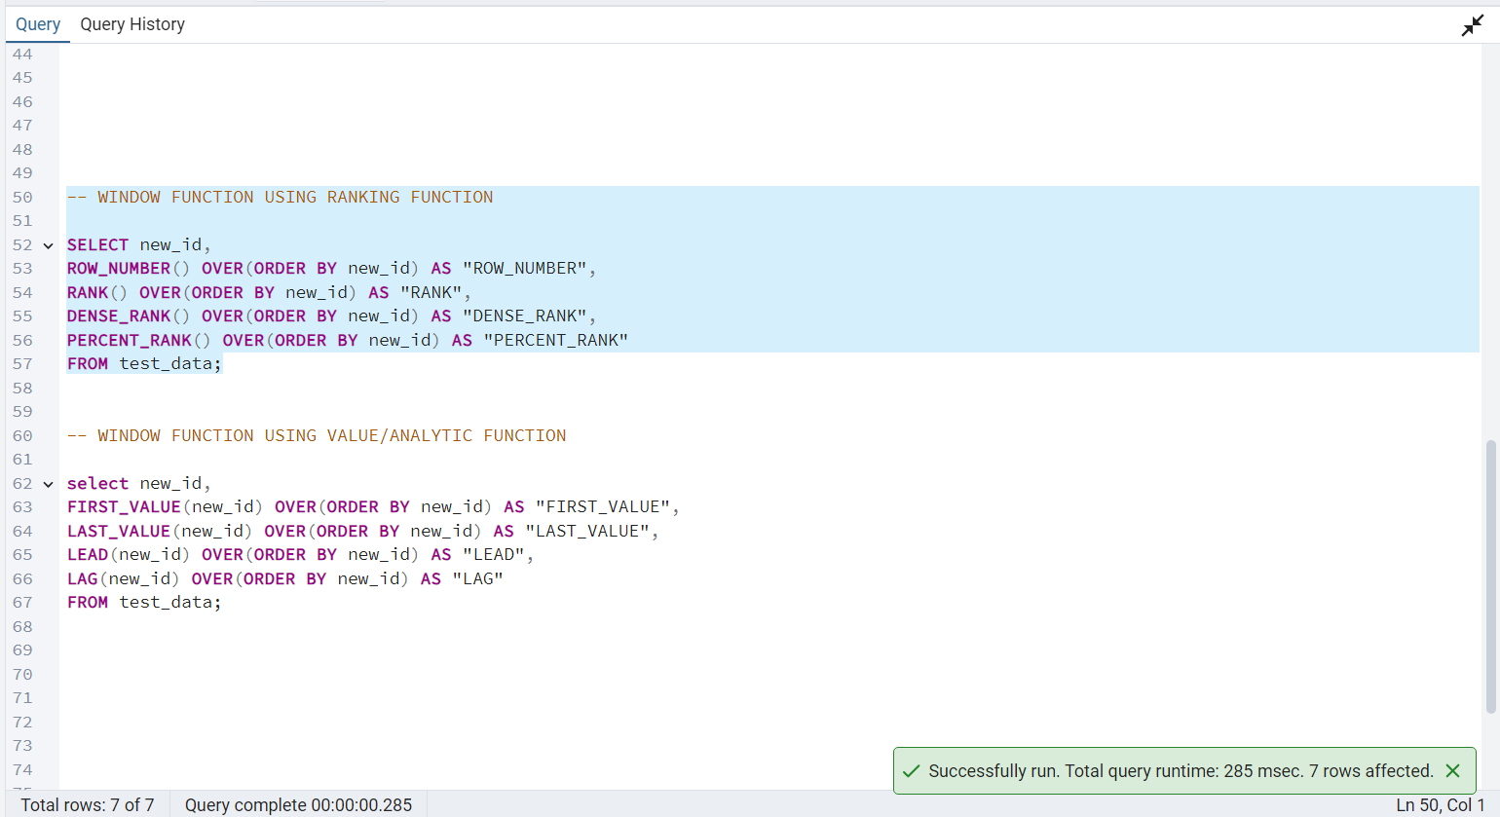
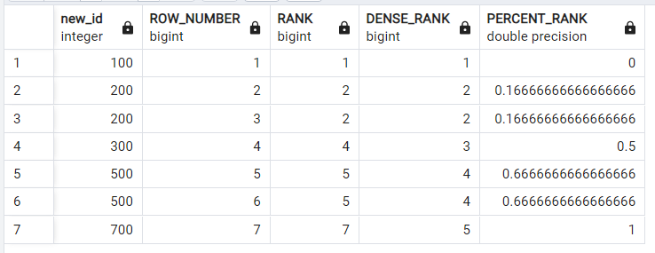
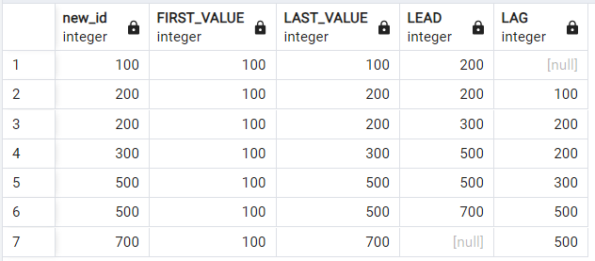

Slide 23
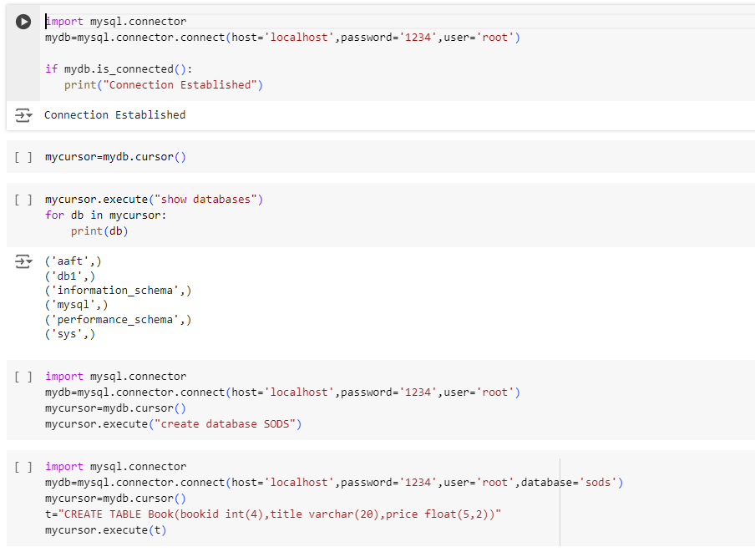
MySQL connectivity with Python

Slide 24
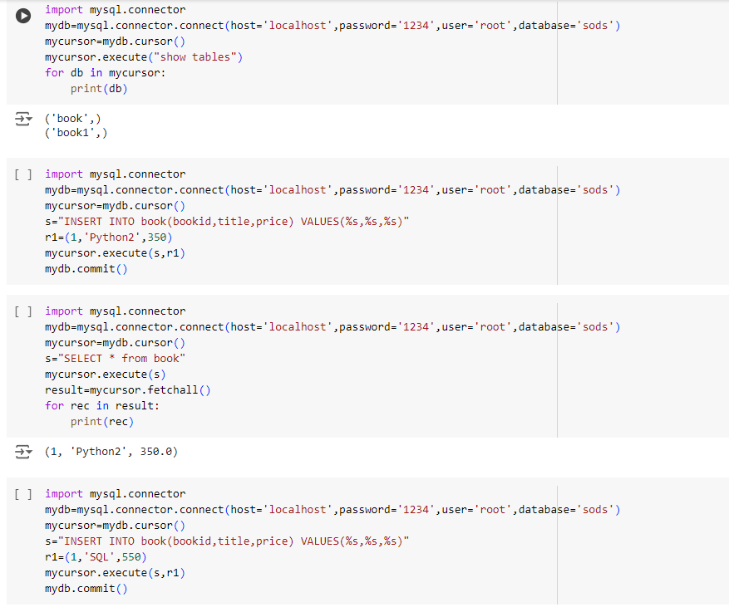

Slide 25
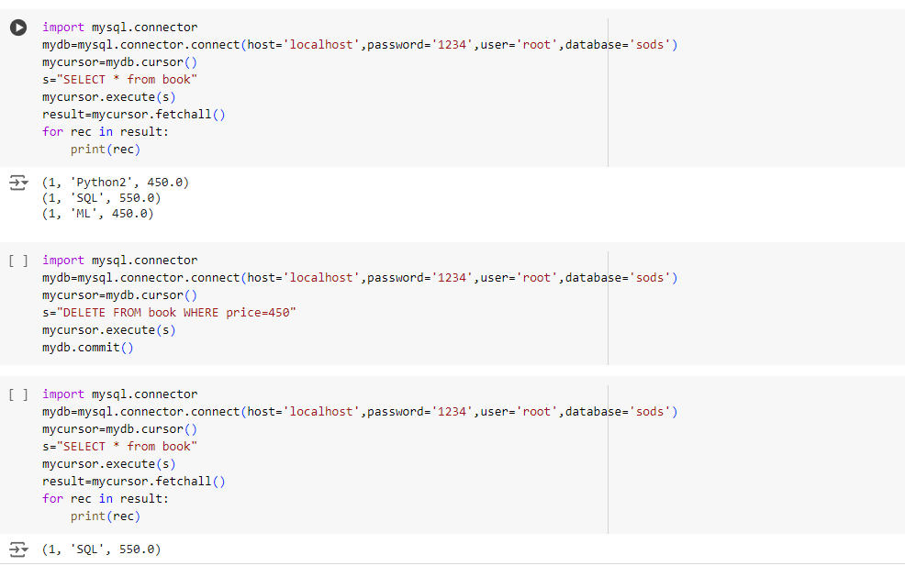

Slide 26
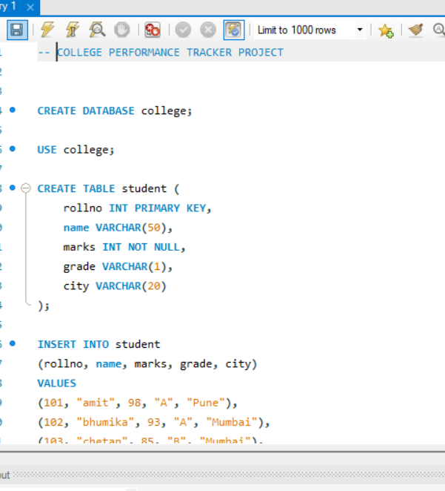
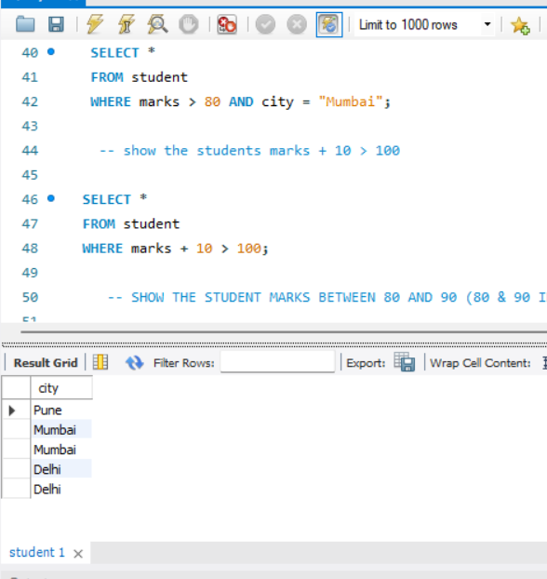
Project : College Performance Tracker

Slide 27

https://github.com/Amit123456777
https://www.linkedin.com/in/amit-sharma-868b3a23a/
amsharma2607@gmail.com

